Slide 1
List of World Heritage Sites of Poland UNesco
Otherwise places that are
worth visiting in Poland

Slide 2
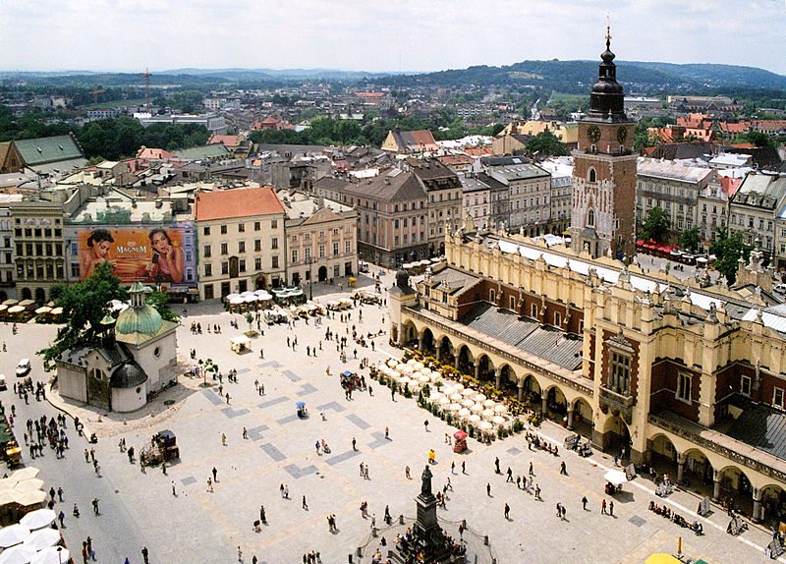
Historic Centre of Kraków
Kraków Old Town is the historic central district of Kraków, Poland. It is one of the most famous old districts in Poland today and was the center of Poland's political life from 1038 until King Sigismund III Vasa relocated his court to Warsaw in 1596. The entire medieval old town is among the first sites chosen for the UNESCO's World Heritage List, inscribed as Cracow's Historic Centre.

Slide 3
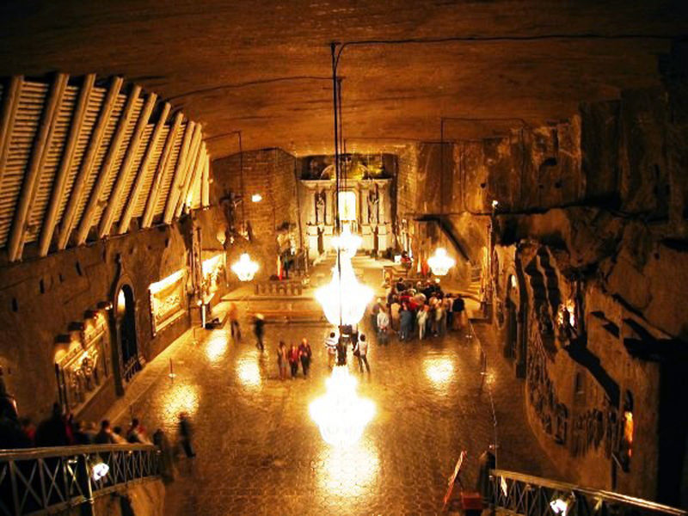
Wieliczka Royal Salt Mine
The Wieliczka Salt Mine, located in the town of Wieliczka in southern Poland, lies within the Kraków metropolitan area. The mine continuously produced table salt from the 13th century until 2007 as one of the world's oldest operating salt mines, for most of this time span being a part of the undertaking żupy krakowskie. It is believed to be the world's 14th-oldest company.

Slide 4
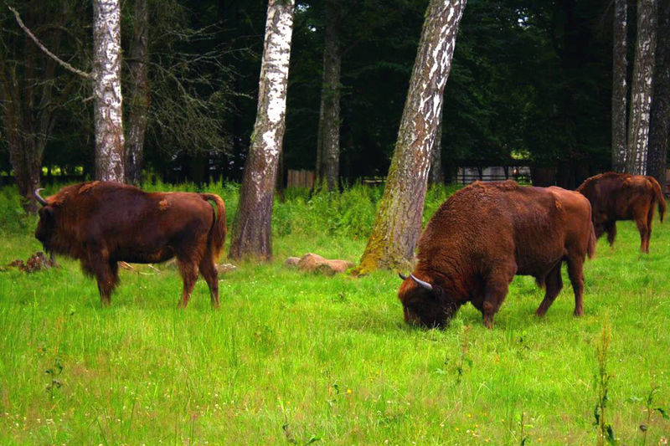
Białowieza Forest
The Białowieza Forest is an ancient woodland straddling the border between the two countries, located 70 km (43 mi) north of Brest (Belarus) and 62 km (39 mi) south-east of Białystok (Poland). It is one of the last and largest remaining parts of the immense primeval forest which once spread across the European Plain. The first recorded piece of legislation on the protection of the forest dates to 1538, when a document issued by King Sigismund I the Old instituted the death penalty for poaching a wisent (European bison).

Slide 5
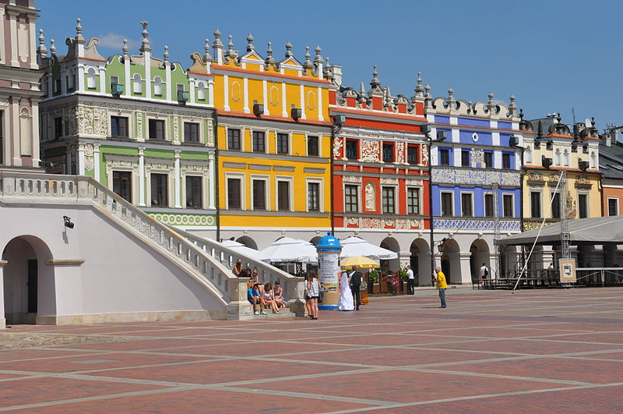
Old City of Zamość
Jan Zamoyski commissioned the Italian architect Bernardo Morando to design the city that would be based on the anthropomorphic concept. The main distinguishing features of the Old Town have been well preserved since its establishment. It includes the regular Great Market Square of 100 x 100 meters with the splendid Townhall and so-called Armenian houses, as well as the fragments of the original fortress and fortifications, including those from the period of the Russian occupation in the 19th century

Slide 6
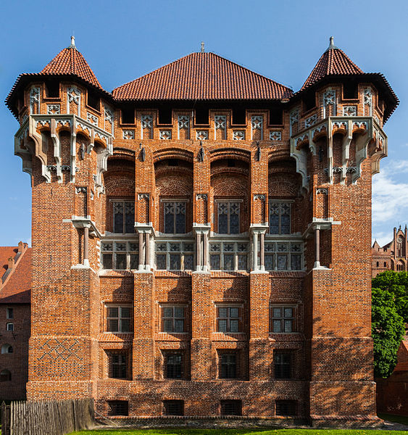
Castle of the Teutonic Order in Malbork
The Castle in Malbork is the largest castle in the world by area. It was built in Prussia by the Teutonic Knights, a German Roman Catholic religious order of crusaders, in a form of an Ordensburg fortress. The Order named it Marienburg (Mary's Castle). The town which grew around it was also named Marienburg. The castle is a classic example of a medieval fortress, and on its completion in 1406 was the world's largest brick Gothic castle.

Slide 7
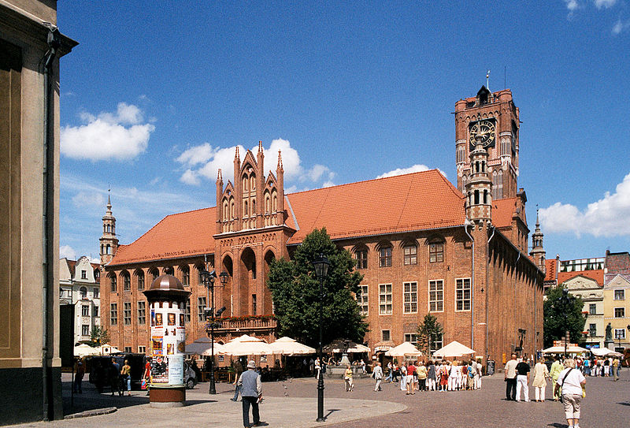
Medieval Town of Toruń
Toruń has many monuments of architecture beginning from the Middle Ages, including 200 military structures. The city is famous for having preserved almost intact its medieval spatial layout and many Gothic buildings, all built from brick, including monumental churches, the Town Hall and many burgher houses. In 1236, due to frequent flooding, the city was relocated to the present site of the Old Town. In 1264 the nearby New Town was founded. In 1280, the city (or as it was then, both cities) joined the mercantile Hanseatic League, and thus became an important medieval trade centre.

Slide 8
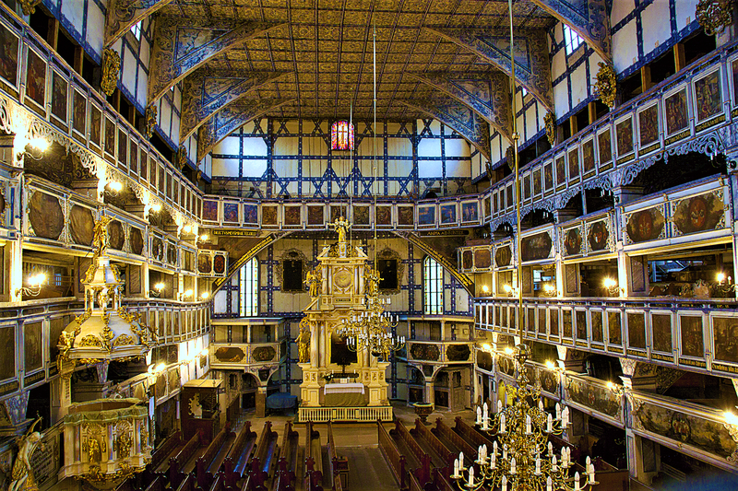
Churches of Peace in Jawor and Swidnica
The Churches of Peace in Jawor and Świdnica in Silesia were named after the Peace of Westphalia of 1648 which permitted the Lutherans in the Roman Catholic parts of Silesia to build three Evangelical churches from wood, loam and straw outside the city walls, without steeples and church bells. The construction time was limited to one year.

Slide 9
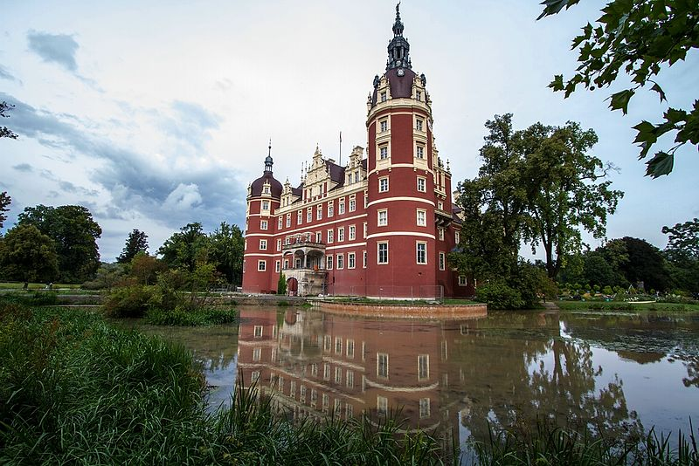
Muskauer Park
The Muskauer Park is the largest and one of the most famous English gardens of Germany and Poland. Situated in the historic Upper Lusatia region, it covers 3.5 square kilometers (1.4 sq mi) of land in Poland and 2.1 km² (0.81 sq mi) in Germany. UNESCO added the park to its World Heritage List, as an exemplary example of cross-border cultural collaboration between Poland and Germany.

Slide 10
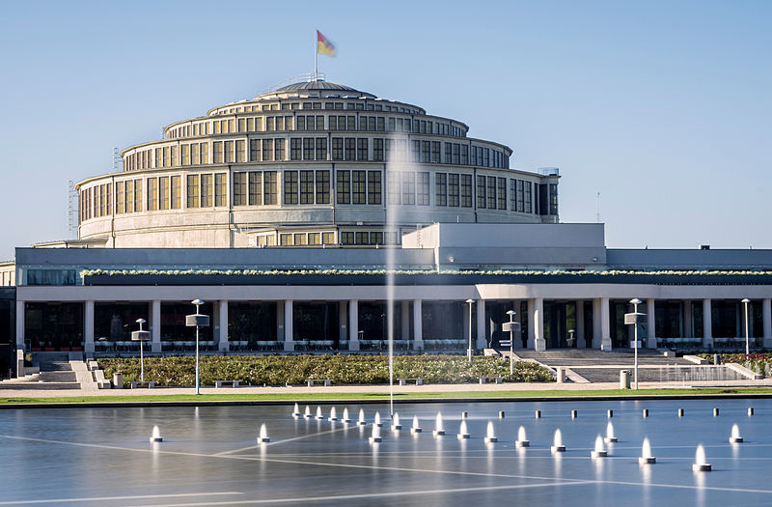
Centennial Hall
The Centennial Hall (formerly People's Hall) is a historic building in Wrocław. It was constructed according to the plans of architect Max Berg in 1911–1913, when the city was part of the German Empire. As an early landmark of reinforced concrete architecture, it was listed as a UNESCO World Heritage Site.

Slide 11
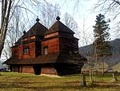
Wooden Tserkvas of Carpathian
Situated in the eastern fringe of Central Europe, the transnational property numbers a selection of 16 tserkvas, churches, built of horizontal wooden logs between the 16th and 19th centuries by communities of the Eastern Orthodox and Greek Catholic faiths. They represent the cultural expression of four ethnographic groups and the formal, decorative and technical characteristics they developed over time. The tserkvas bear testimony to a distinct building tradition rooted in Orthodox ecclesiastic design interwoven with elements of local tradition, and symbolic references to their communities’ cosmogony. The tserkvas are built on a tri-partite plan surmounted by open quadrilateral or octagonal domes and cupolas. They feature wooden bell towers, iconostasis screens, and interior polychrome decorations as well as churchyards, gatehouses and graveyards.

