Slide 1
TRAVELLING DIARY DZIENNIK PODRÓŻY
EUstudents in EUwonderland
Adventures of Erasmusy, the teddy bear
Podróże misia Erasmuska

Slide 2
ERASMUSY, THE TEDDY BEAR
Our travelling buddy will join us on our trips and help us with our tasks.

Slide 3
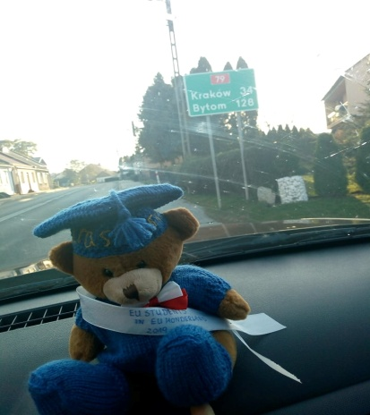
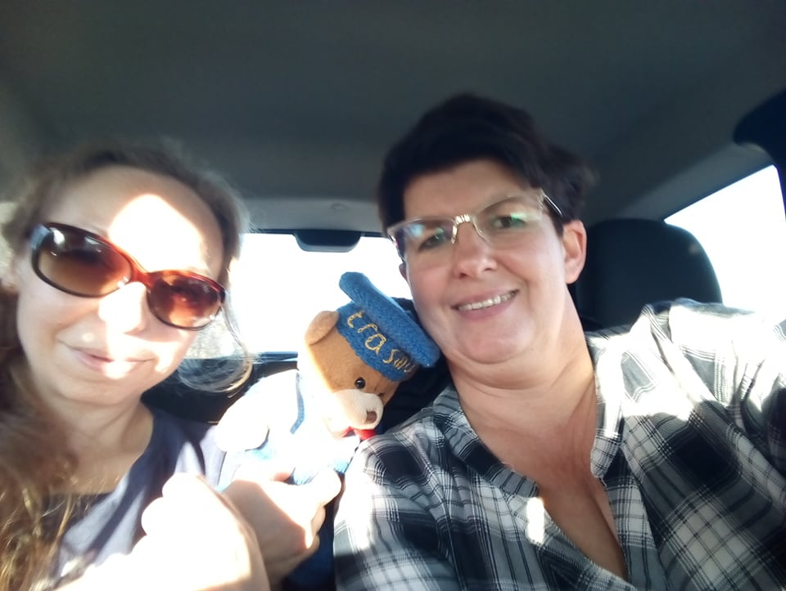
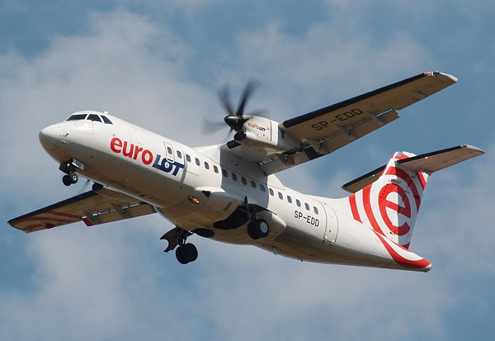
First day
Car, airplane and car again
14.10.2019
Today we Begin our adventure with new project ERASMUS +. Full of hope we hurry to Razgrad in Bulgaria.
The first phase of our journey: From Karczmiska to Kakow we drive with Lidka’s husband, Mirek
The second phase: up in the air we fly from Krakow to Bucharest

Slide 4
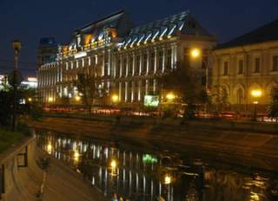
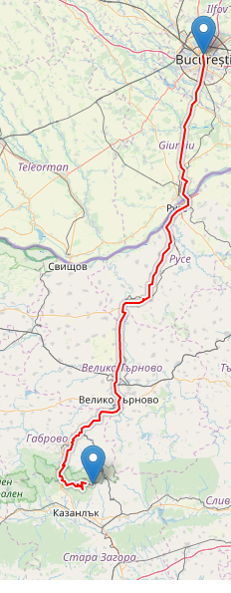
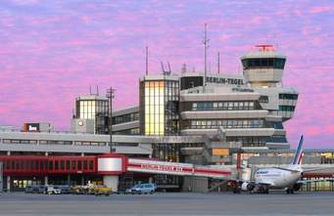
Romania in the night is magnificent, but there is the last phase of our journey before us. We have to get from Bucharest to Razgrad in Bulgaria. Although we are late, we are eager to meet everyone from the project!
TU WSTAW ZDJĘCIE JAK SIĘ DO TAKSY PAKUJECIE
And to Razgrad we go…

Slide 5
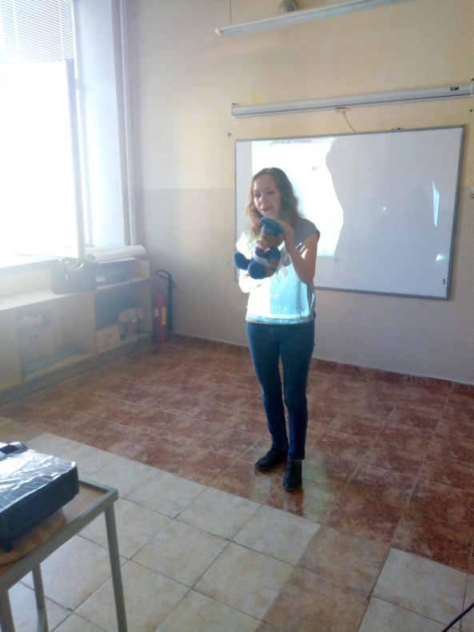
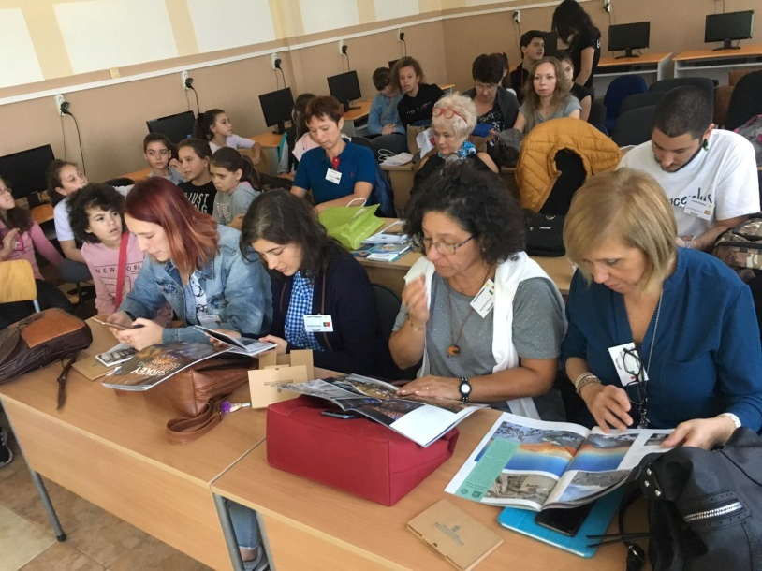
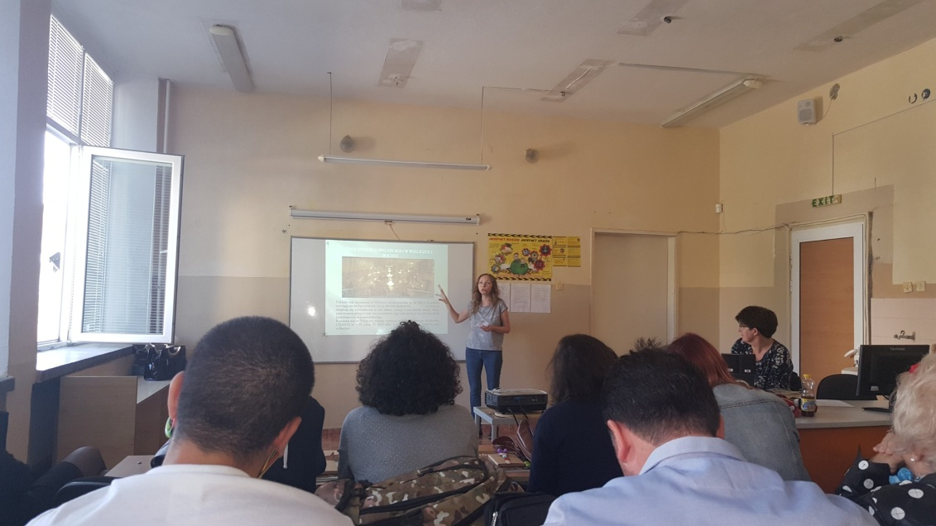
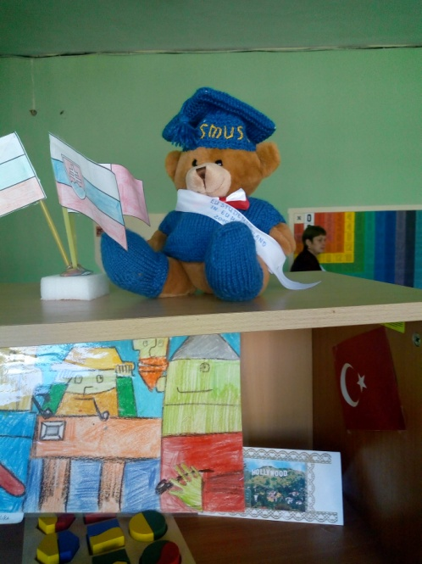
In Razgrad -Partners present presentations about Cultural Heritage of their countries

Slide 6
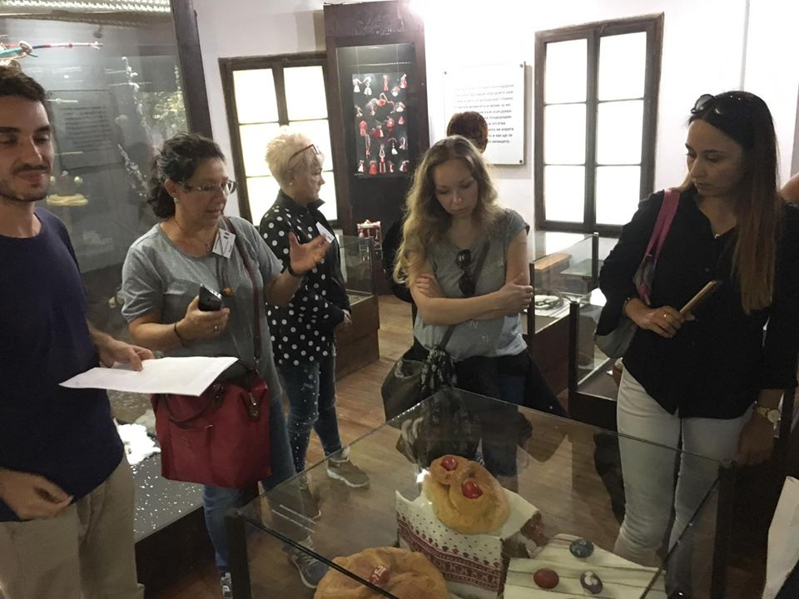
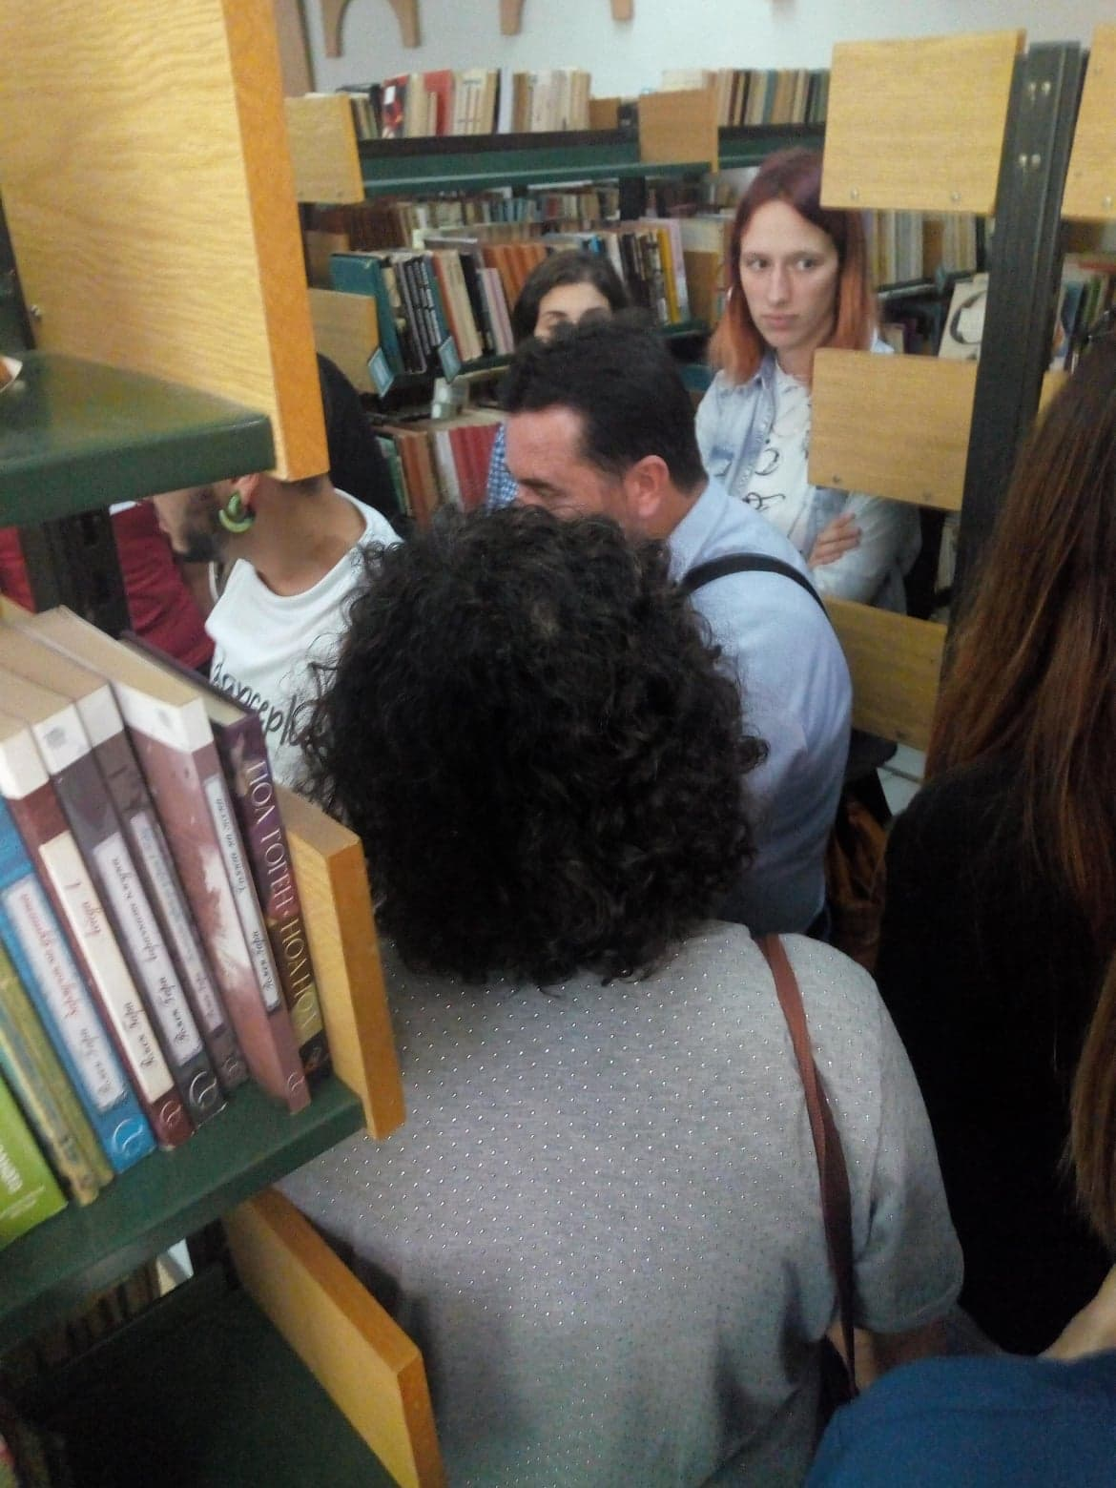
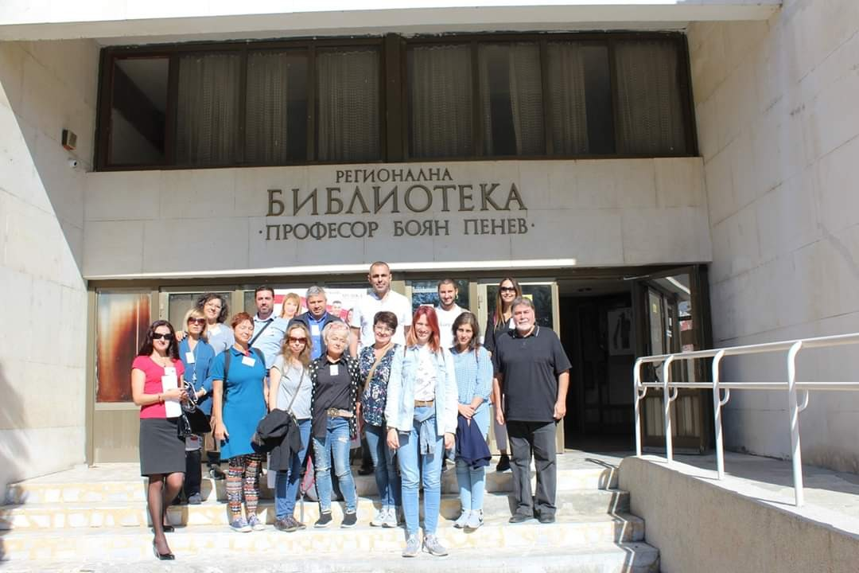
Departure for the City library “Prof. Boyan Penev”

Slide 7
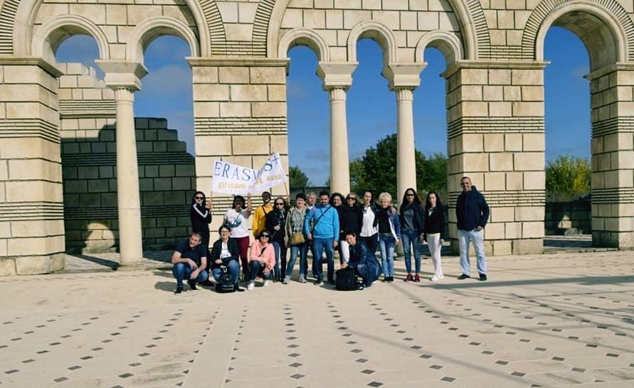
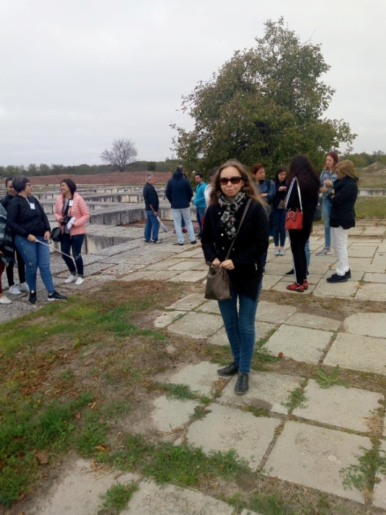
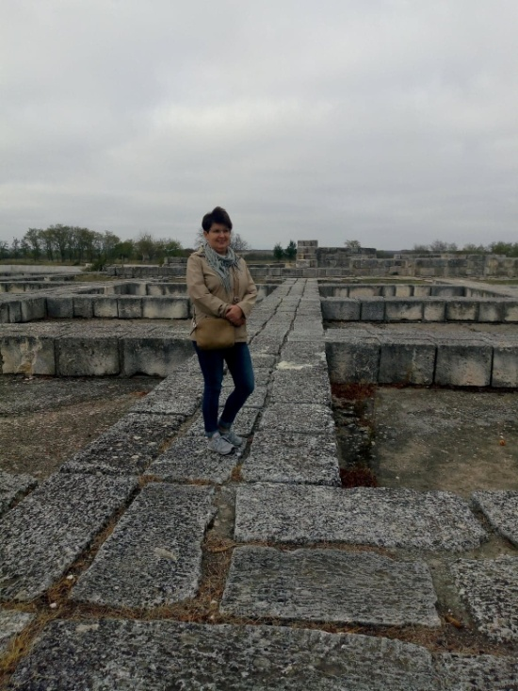
Vizit of cities Pliska,Preslav (ancient Bulgarian capitals),

Slide 8
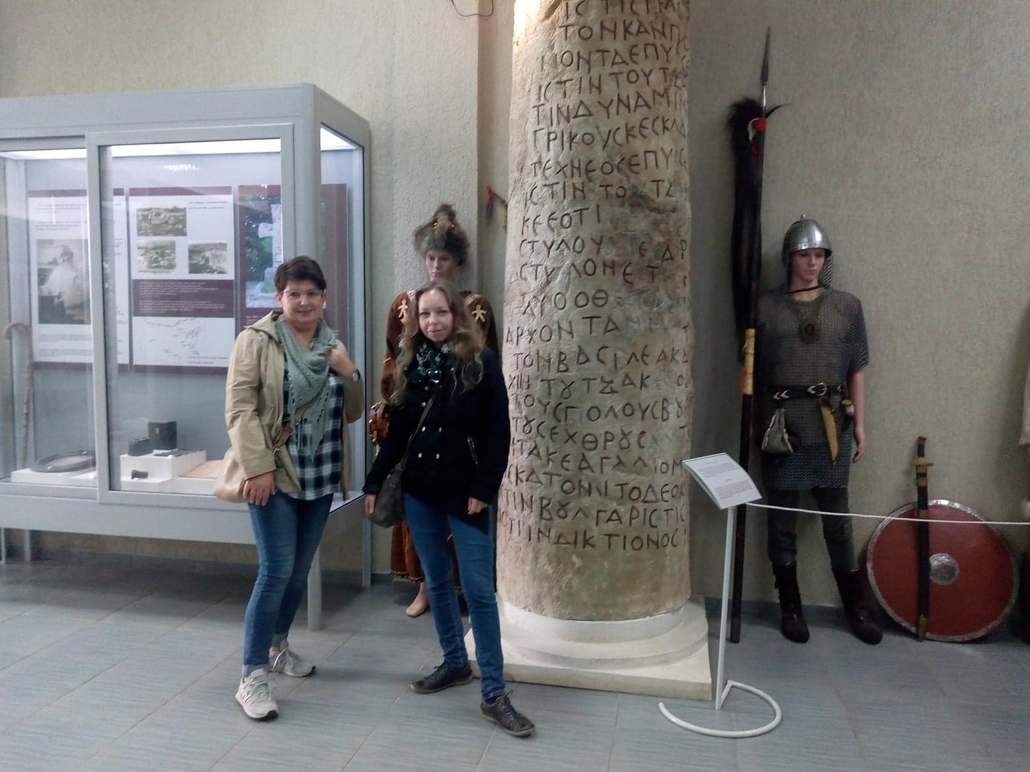
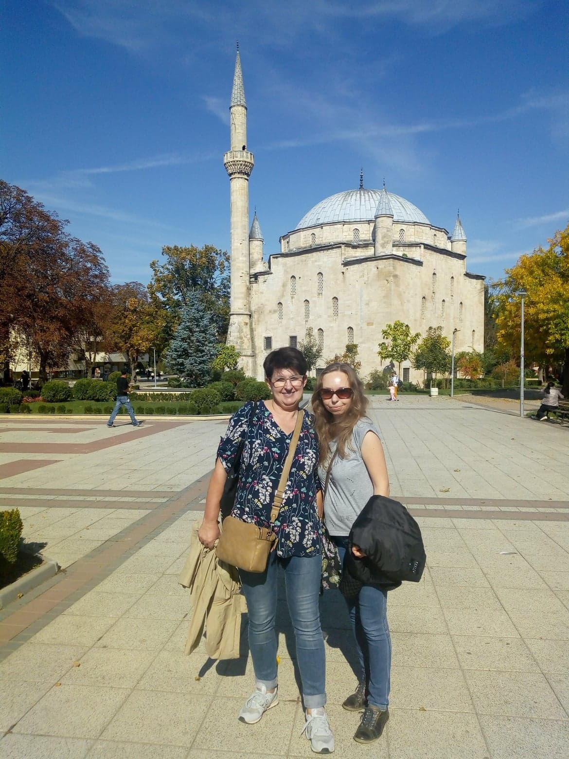
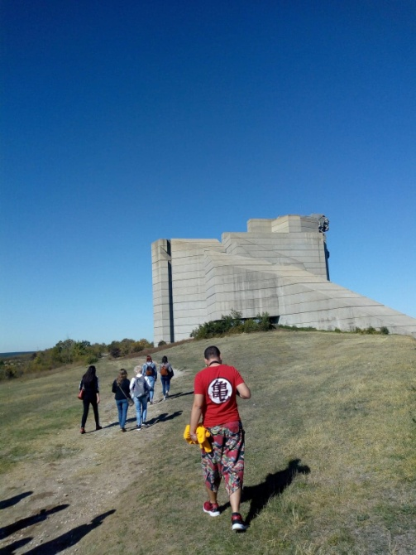
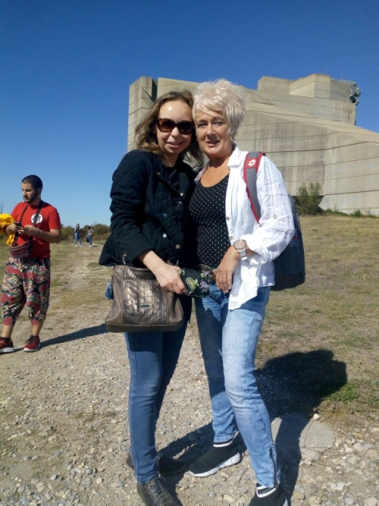
Wspomnienia… memories

Slide 9
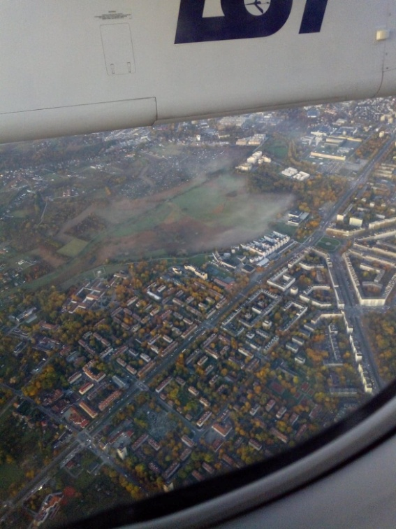
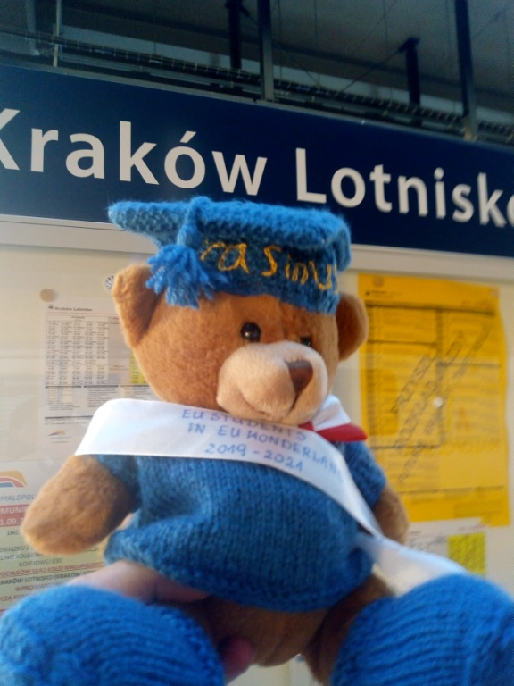
Czas wracać…. it's time to go back
Razgrad Bukareszt
Kraków
Karczmiska

